Slide 1
Test reinforcement learning for well trajectory automation
Team Dogleg, Summer internship 2020

Slide 2
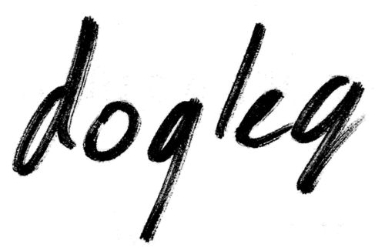
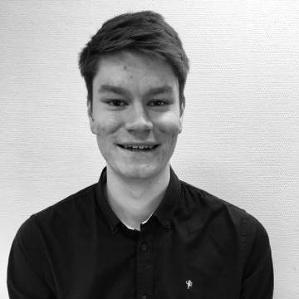
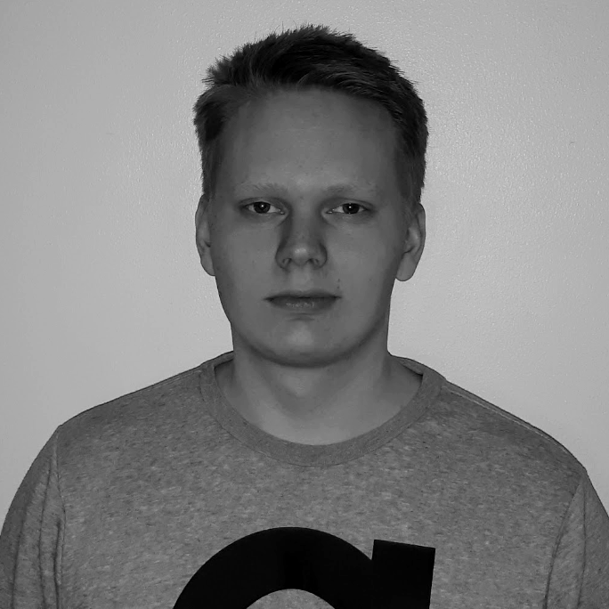
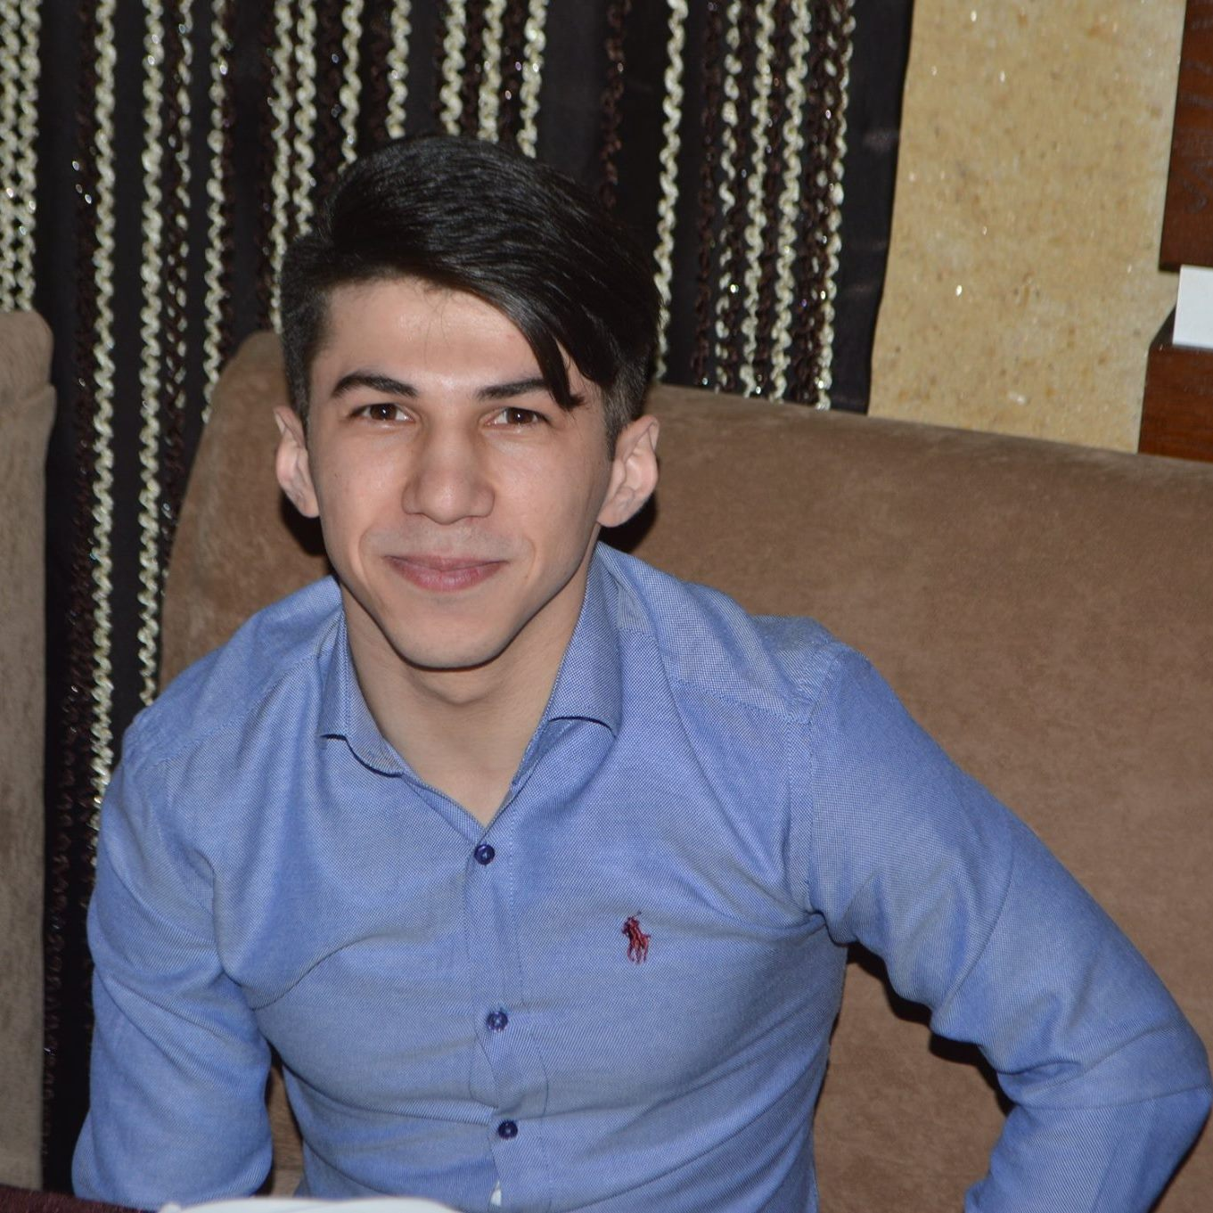
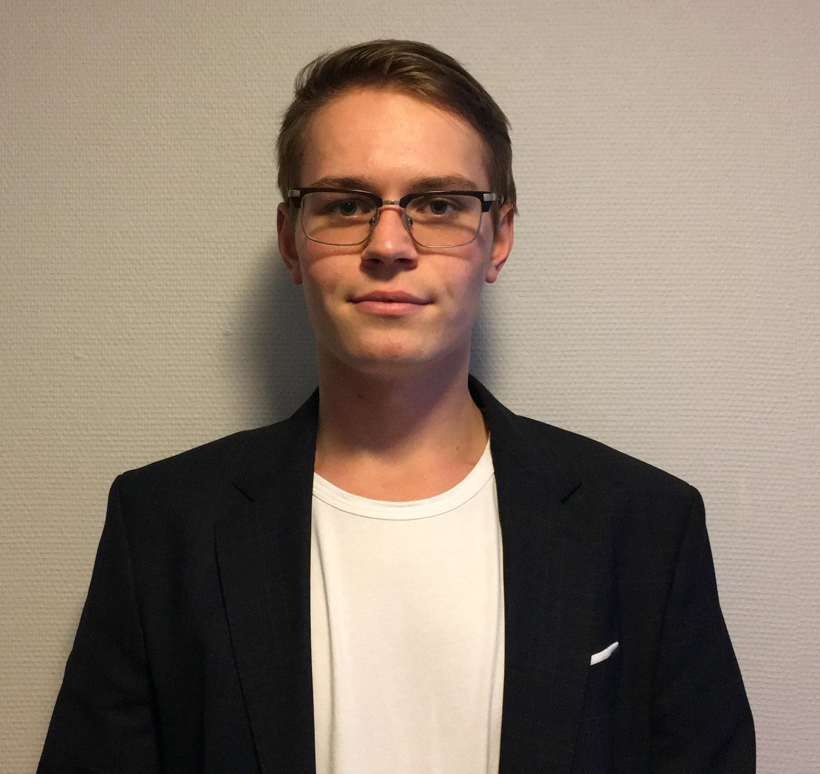

Who are we?
Jakob, 21
NTNU, Trondheim
Håkon, 22 UiT, Tromsø
Ayaz, 23
NTNU, Trondheim
Martin, 23
UiS, Stavanger
Martin, 24
NTNU, Trondheim

Slide 3
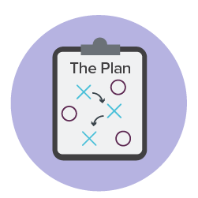
Outline of the presentation
What are we going to be talking about?
Our expectations
Remote work challenges
Introducing the case
Progress and results
Discussing the results
Personal reflections

Slide 4
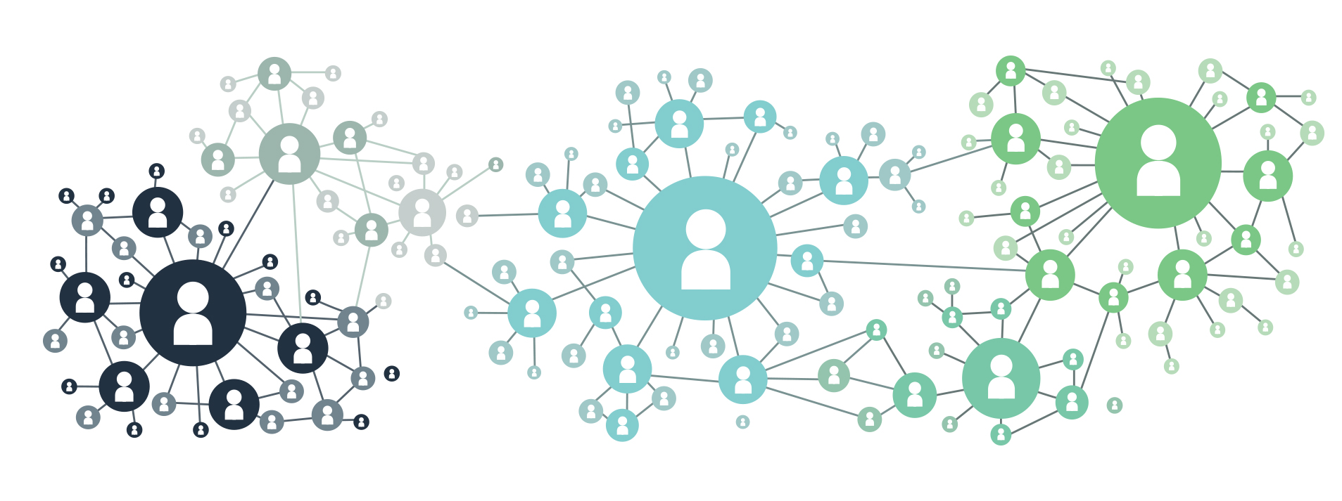

Our expectations to the virtual internship
Gain valuable experience to use further in work and study
Learn practical use of AI
Get to know new people and build a bigger network (not only a neural one)

Slide 5


Our experience working virtually from home
A normal day would look something like this:
Daily morning meeting.
Discuss progress and issues with the group and mentors
Work amongst ourselves. Use slack for communication and call for more meetings if needed
Afternoon meeting. Discuss progress and issues with the group
Work amongst ourselves. Use slack for communication and call for more meetings if needed

Slide 6

Our experience working virtually from home
Pros:
Short commute time to work (you can wake up 5 minutes before work)
Endless cooking opportunities in your own kitchen
You can wear sweatpants and no one will know
Cons:
Work life balance. You don’t have a dedicated office where you work (we sleep in our offices)
Harder to be social and get to know each other
Harder to do social activities to "bond".
No common lunch room chat
Conversations are always smoother when you are meeting physically
Notes:
Remember to say that the first bullet point is inline with Equinors strategy: "Always safe, high value, low carbon"

Slide 7
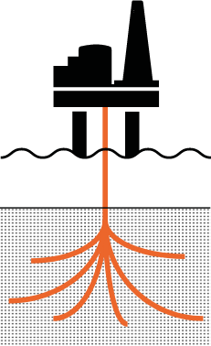
"Automate well trajectory planning using
reinforcement learning"

Slide 8

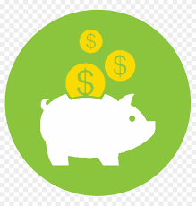
The case: Motivation
Equinor drills nearly 100 development wells each year = Huge investment
Manual well planning = Not quite optimal well trajectory
Even minor trajectory optimizations can have a large impact. Example:
- 50 m shorter well = 2 - 4 MNOK saving in money
Why automation?
Optimal well trajectory
Saving time
Improved well deliveries

Slide 9

The case: Goal
Create a piece of software that, given a set of target balls you want to reach, find the best possible path to the targets in a subsurface environment
As "simple" as that!

Slide 10


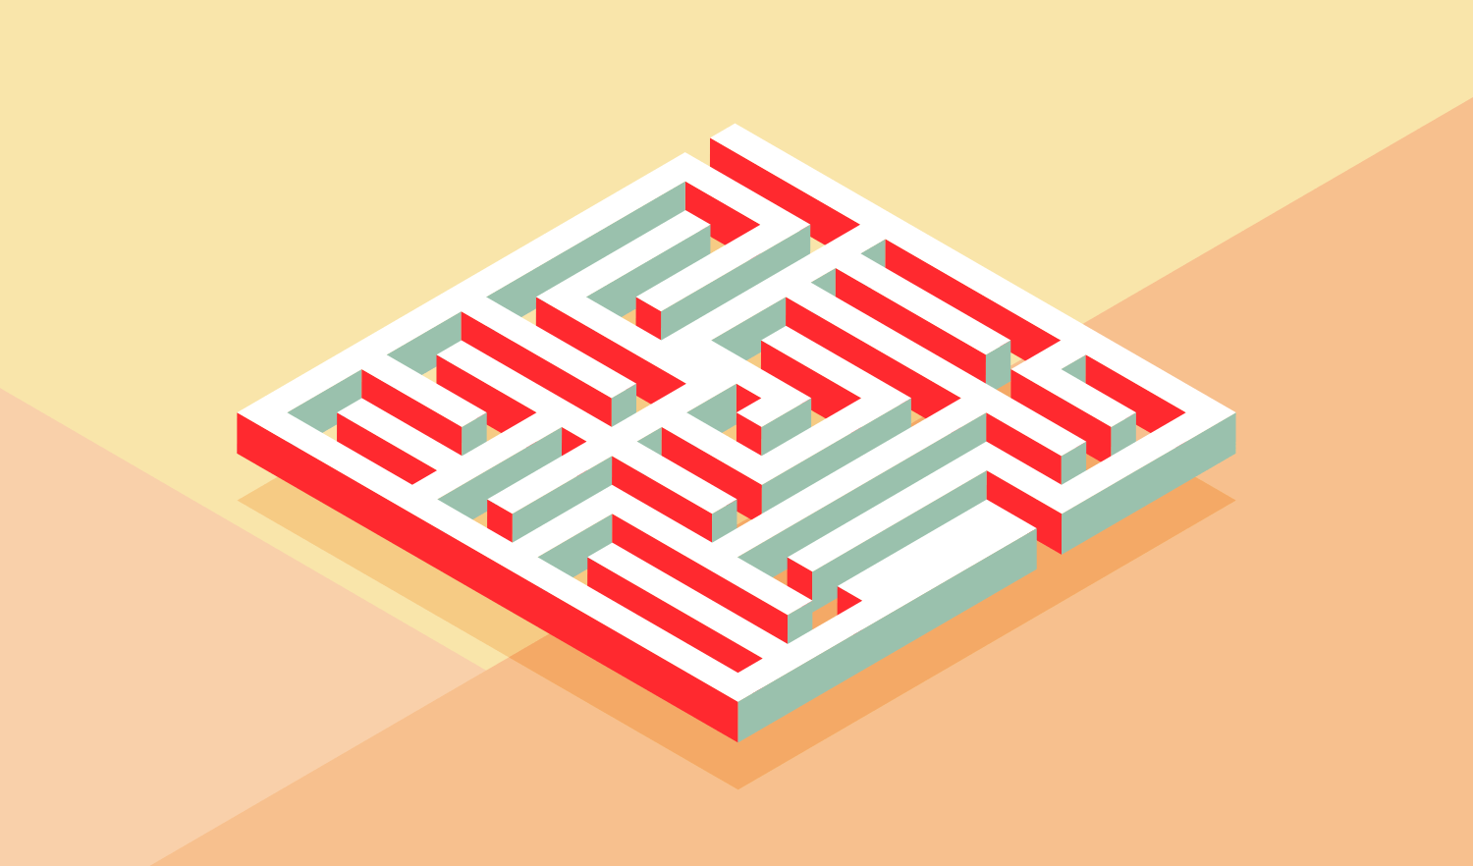
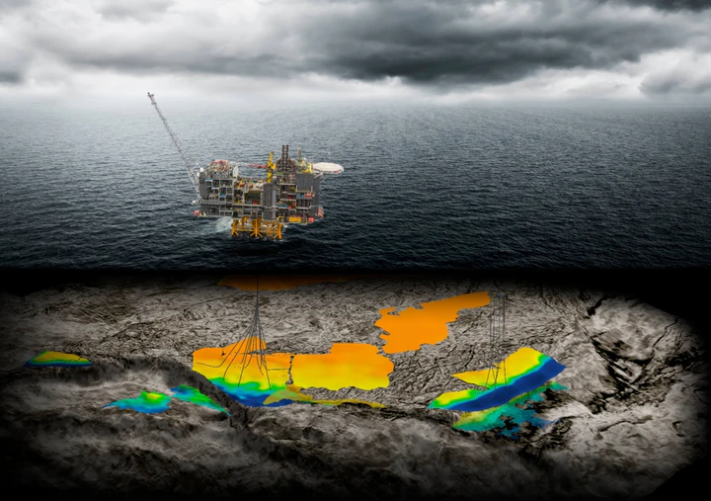
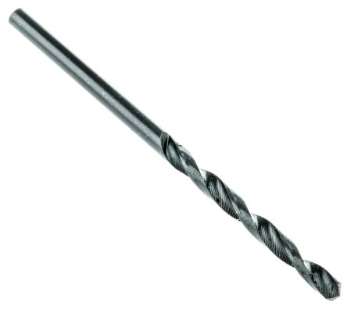
What is Reinforcement Learning?
General Case:
Agent
Operates in an environment
Our case:
Drillbit
Subsurface environment
Notes:
Assuming that prior to the slide we have mentioned:
That we want to automate the generation of well paths using machine learning. We will be using a branch
of Machine Learning called "Reinforcement Learning" (more on that later)
On this slide, mention:
That the general idea is that we have what we call an "agent", which operates in some sort of environment. From the POV of the agent, this environment can be seen as a maze

Slide 11
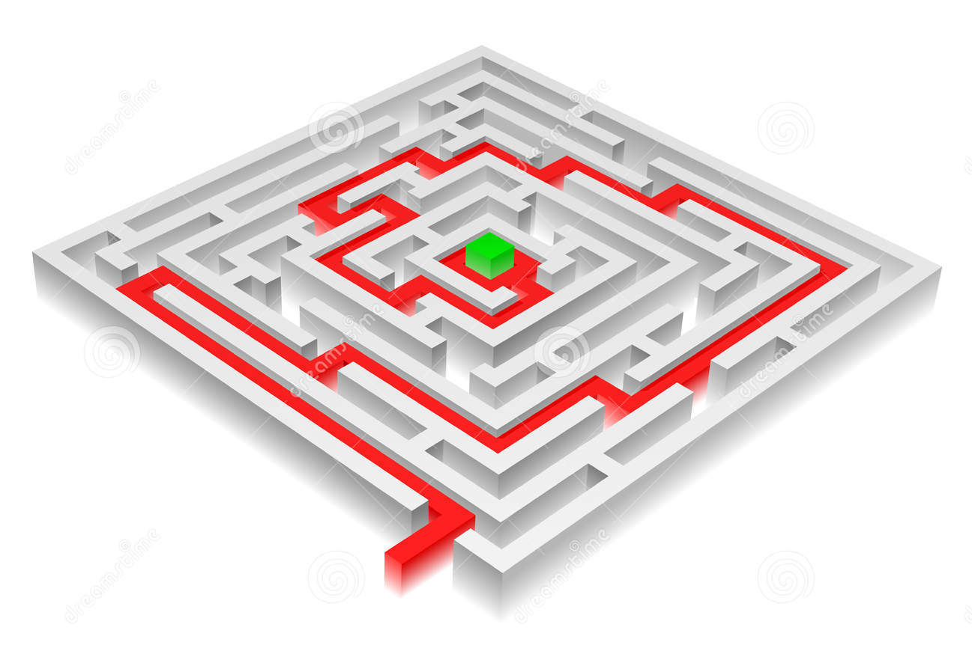
The reinforcement learning goal:
"The agent should learn what actions to take in order to solve the problem"

Slide 12
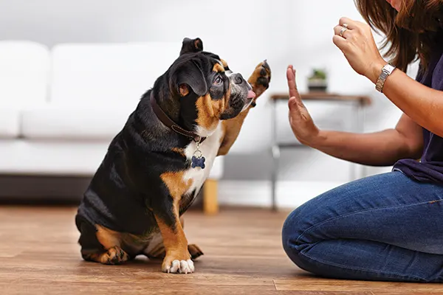
How does this "Agent" learn?
Notes:
How does the agent figure out how to best take the actions to get to the finish line in the maze?
We reward

Slide 13
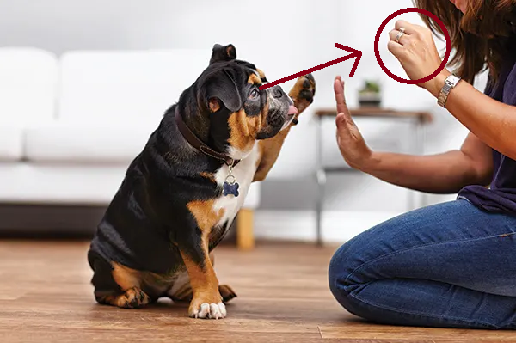
How does this "Agent" learn?
Eyes on the price!
Notes:
How does the agent figure out how to best take the actions to get to the finish line in the maze?
We reward

Slide 14
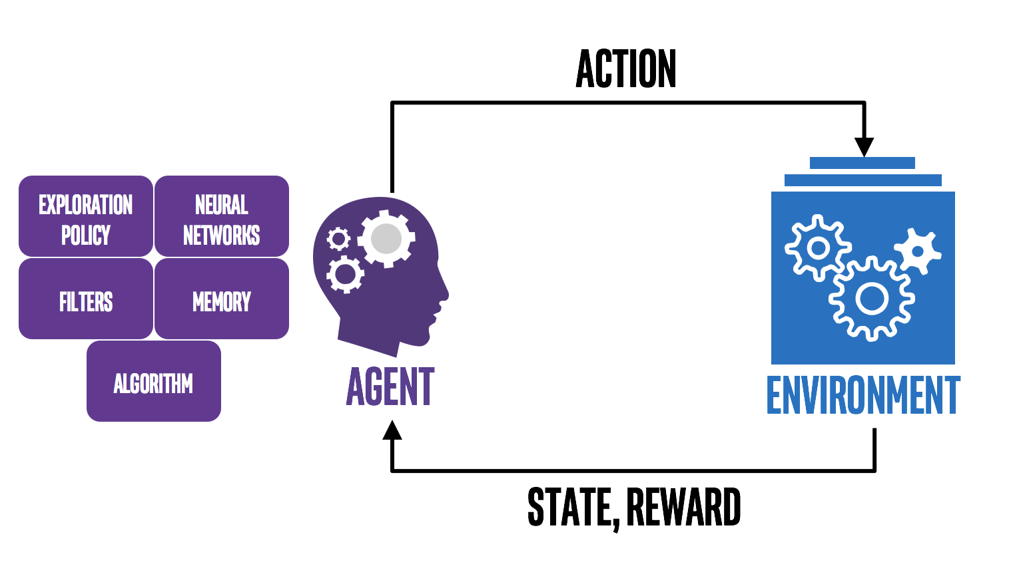
How does this "Agent" learn?

Slide 15
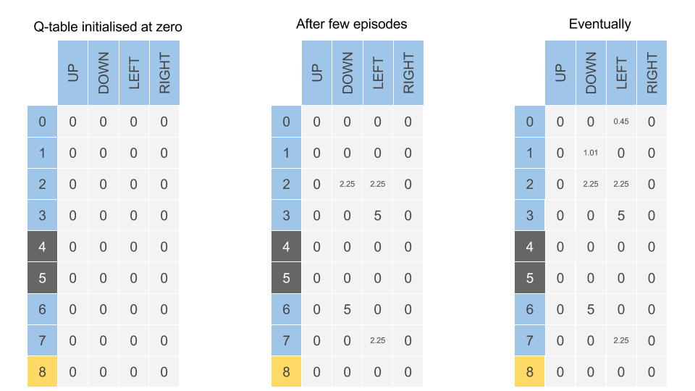

How does this "Agent" learn?
Explores different actions in different states of the environemnt
Updates the "Q table" with the reward it got for a specific action in a specific state

Slide 16
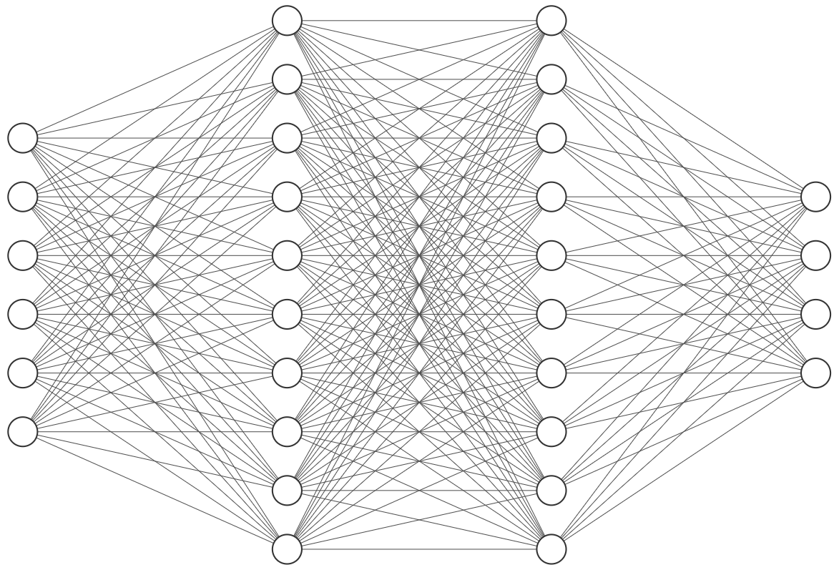
The Q-table "issue"
If the agent has a lot of actions available, and the environment is big, the resulting Q table will be big
We use a Neural network to estimate the rewards values in the Q table
Q-table
Neural Network

Slide 17
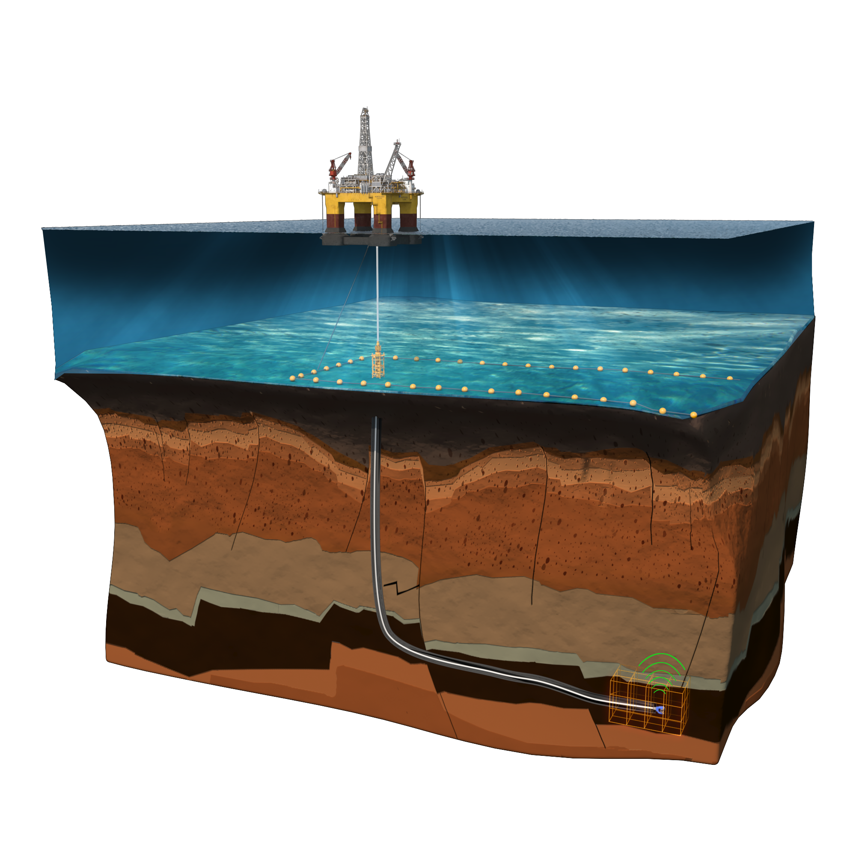
Reinforcement learning: Our objective
Create a representation of the subsurface environment which inflicts the real life limitations of drilling
Introduce a reward system which "guides" the agent to the most optimal path, while subject to the real life constraints
Notes:
Mention here: Limitations are no go areas (hazards) and god leg severity which will be discussed soon

Slide 18
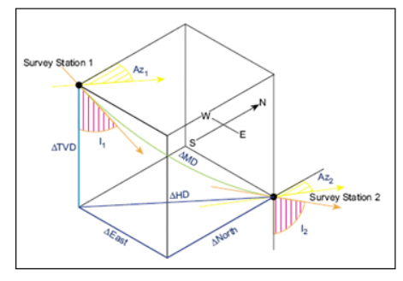
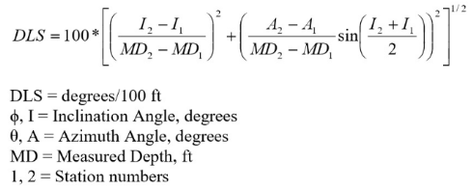
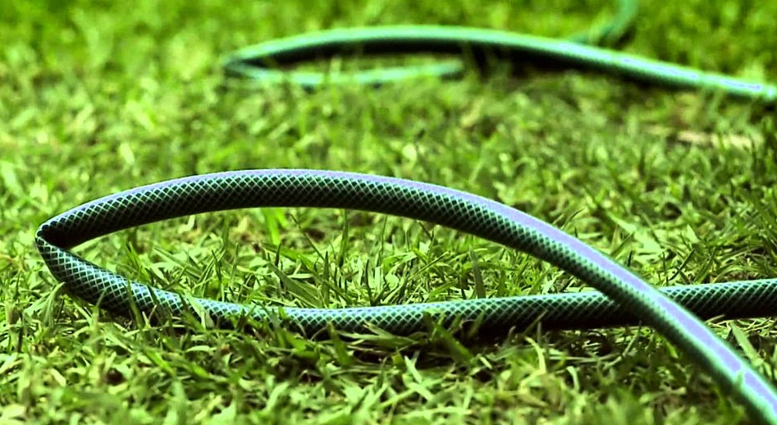
Limitation: Dogleg Severity
What does Dogleg Severity (DLS) mean?
Change in direction of a wellbore over a defined length
Measured in degrees/100 ft or degrees/30 m
Why do we measure Dogleg Severity?​
Damage can be done to the drill string​
Drill string may get stuck in the dogleg curve
How do we calculate Dogleg Severity?
This is hard, so what can we do instead?
Use a proxy for dogleg severity

Slide 19
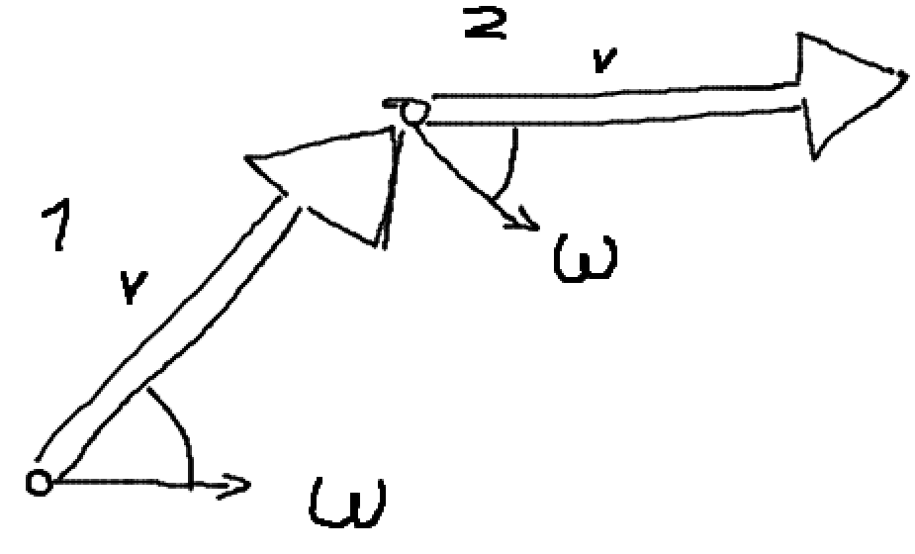
Limitation: Dogleg Severity
The DLS proxy must ensure a smooth well trajectory
Take the derivative of the inclination angle
-> Unit will be degrees per time, ie. angular velocity
Take the derivative of angular velocity
-> Unit will be degrees per time squared, ie. angular acceleration
Set limitations on angular velocity and angular acceleration
Let agent manipulate angular acceleration
How angular velocity (ω) changes the inclination (v) from timestep 1 to 2
Notes:
Håkon

Slide 20
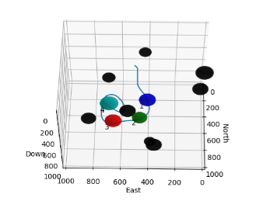
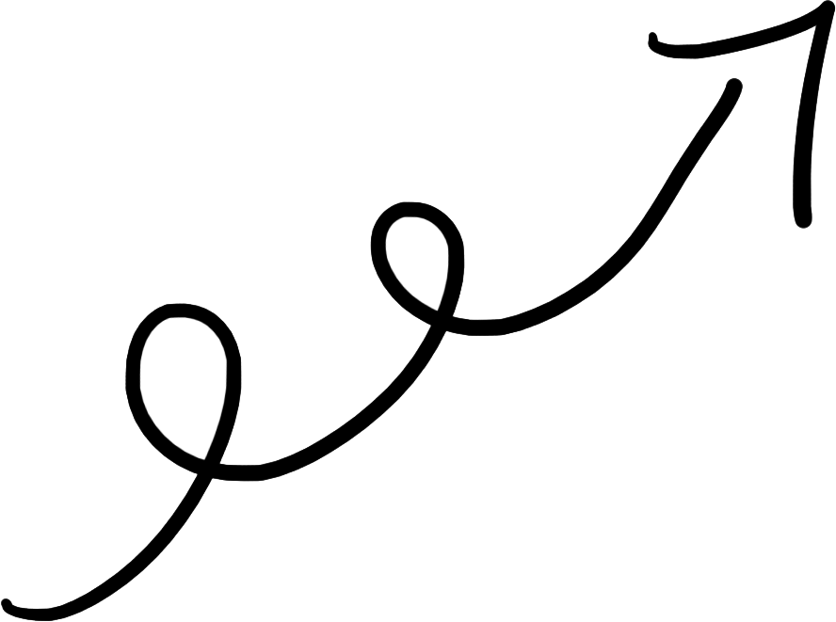
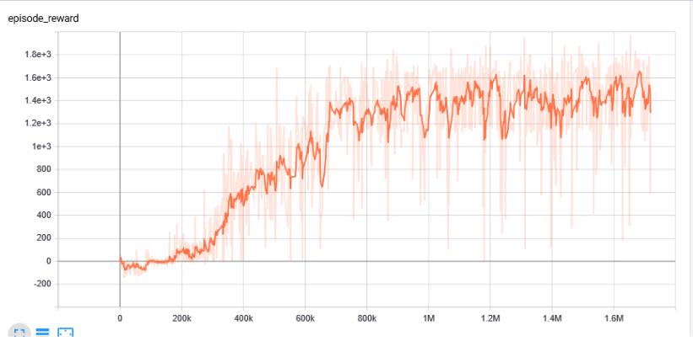
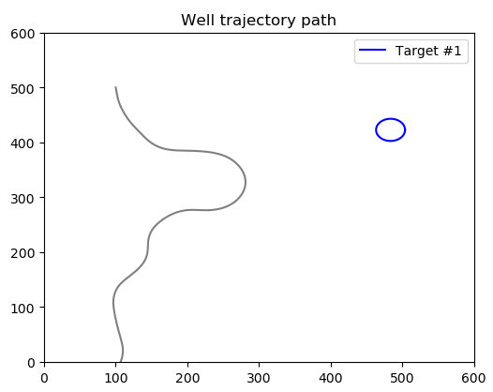
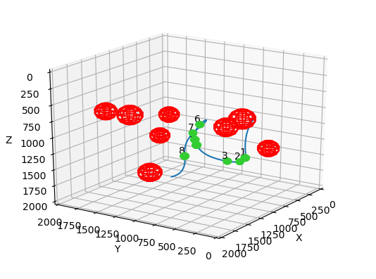
Progress and results

Slide 21
Progress and results: Making a 2D environment
Agent moving through the environment with a movement vector of constant magnitude
3 possible actions:
1) Accelerate left
2) No change in angular acceleration
3) Accelerate right
** Limiting the maximum angular velocity and acceleration

Slide 22
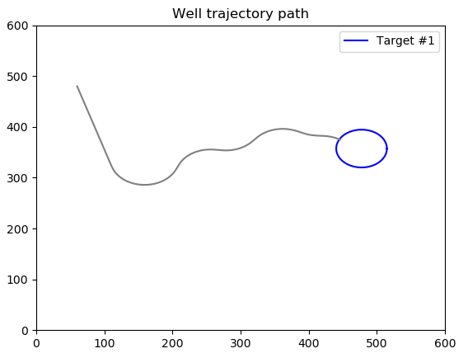
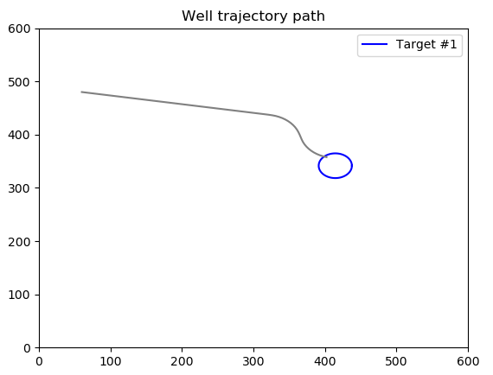

Progress and results: Training an agent
"What kind of behavior do we want to reward?"
Efficient path
Smooth trajectory
Constant agular velocity?...
Notes:
As the environment was in place, the next step was to train the agent. Then a natural question appeared: "Which behavior do we want to reinforce in the agent". If we just reward it for hitting the target, then we can get a lot of ugly results (like the one on the left). Of course we want the path to be as efficient as possible, which means that we don't want it to make these unnecessary turns. So to make the agent truly understand how we wanted it to act, we have been doing a lot of experimenting on our reward-system during these seven weeks

Slide 23
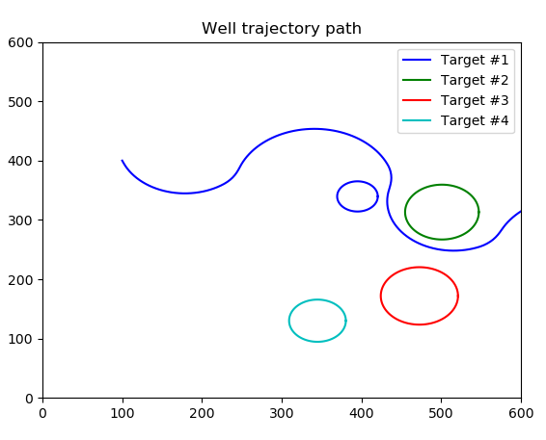
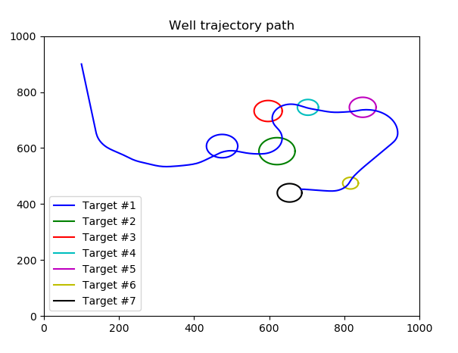
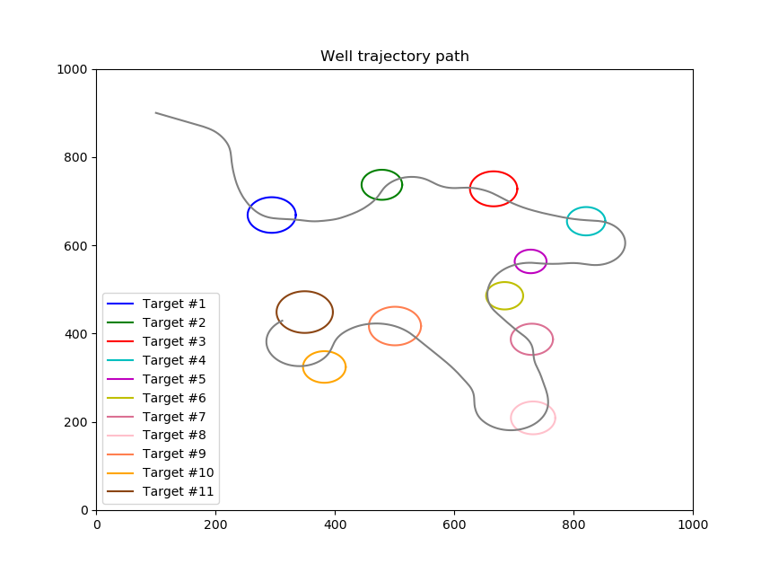
Progress and results: Training with multiple targets
Gradually increasing the complexity
Notes:
As the agent had passed the first test, we figured it was time to increase the complexity by adding more target balls. Initially this problem seemed to be much harder to solve, but after playing around with the rewards and the observable states of the agent, the performance really improved. As you can see from the figures, the agent was able to hit all of the target balls in a quite efficient way.
[[We should probably mention when showing these plots, that if there are any "oil people" in the audience, the positioning of the targetballs may look unrealistic. It is however an important point that in training the agent should be exposed to all kinds of combinations of targetballs to not overfit the training.
A real life comparison can be if you are preparing for an exam, you don't just want to practice on the easy questions, you would like to train on the harder tasks as well so that you are even more prepared for whatever you will meet on the exam. Same thing can be said about our agent training in the environment

Slide 24

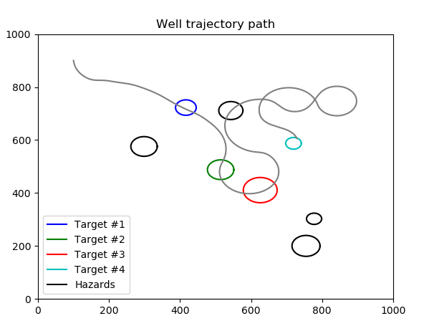
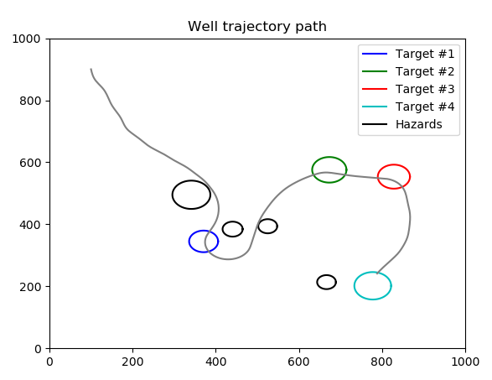
Progress and results: Adding hazards
Introducing danger zones that we want to avoid
Notes:
The next step was then to introduce hazards to the environment. These hazards, or danger zones if you will, are areas that we want to avoid and are illustrated as black circles in the figures. As you can see on the figure on the left, the agent needed some time to understand how to avoid these hazards, but after a while it seemed to adapt also to this environment.

Slide 25
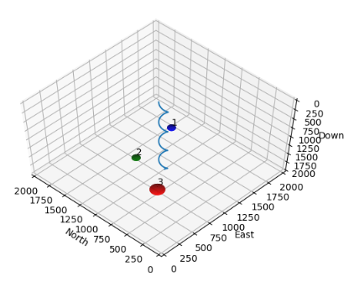
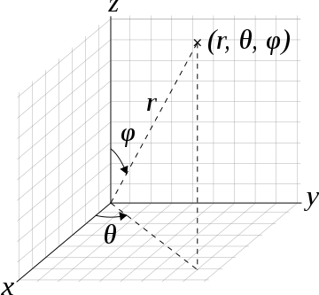
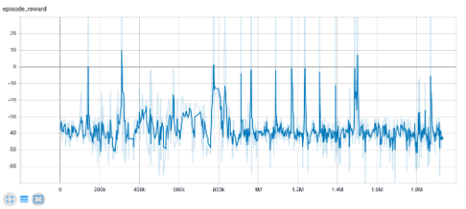
Progress and results: Expanding to 3D
Using spherical coordinates to describe the direction of the drill-bit
3 initial discoveries:
The number of states and actions grew large
The agent struggled to make sense of the data
Many of the randomly spawning targets was very hard to hit
* inverted z-axis
Notes:
As 2D was starting to get quite safe and sound, we expanded the environment to 3D. We then decided to use spherical coordinates to describe the direction of the drill-bit. And as we started experimenting with this new environment we did 3 initial discoveries. [1]: This again led to the second discovery, that[2]: This was indicated by the two figures to the right. As you can see from the bottom-right figure, the episode-reward never seemed to converge at a higher level. And the last discovery was that:[3]
explain graph

Slide 26
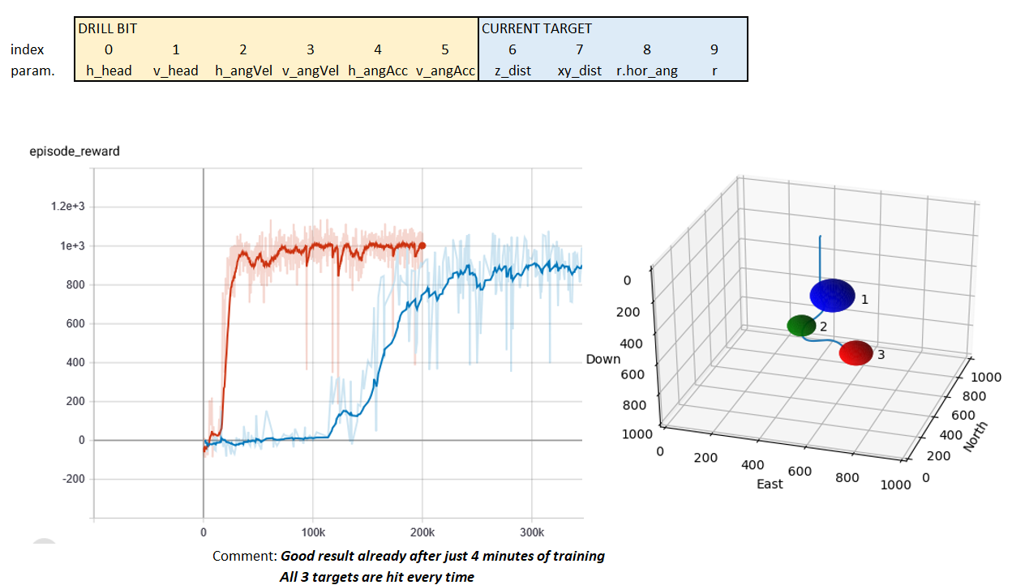
Progress and results: Testing a more compact state-space
Fewer visible states
States more directly linked to its actions
Rewarded for minimizing the deviation from the desired position
Result: Improved sample efficiency and general performance
Notes:
As the agent seemed to struggle to make sense of the growing number of states, we wanted to do some testing where we presented the agent with a limited amount of states that was more directly linked to its actions. We then ditched a bunch of states and replaced them with a few new ones. [Namely the height-difference, the horizontal distance and the relative azimuth angle to the next target]… and as we rewarded the agent for minimizing these sort of deviations it drastically improved the learning-rate and the general performance of the agent.

Slide 27
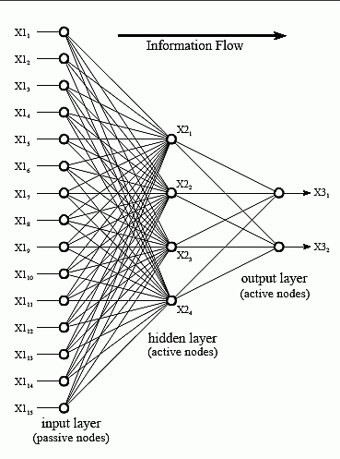
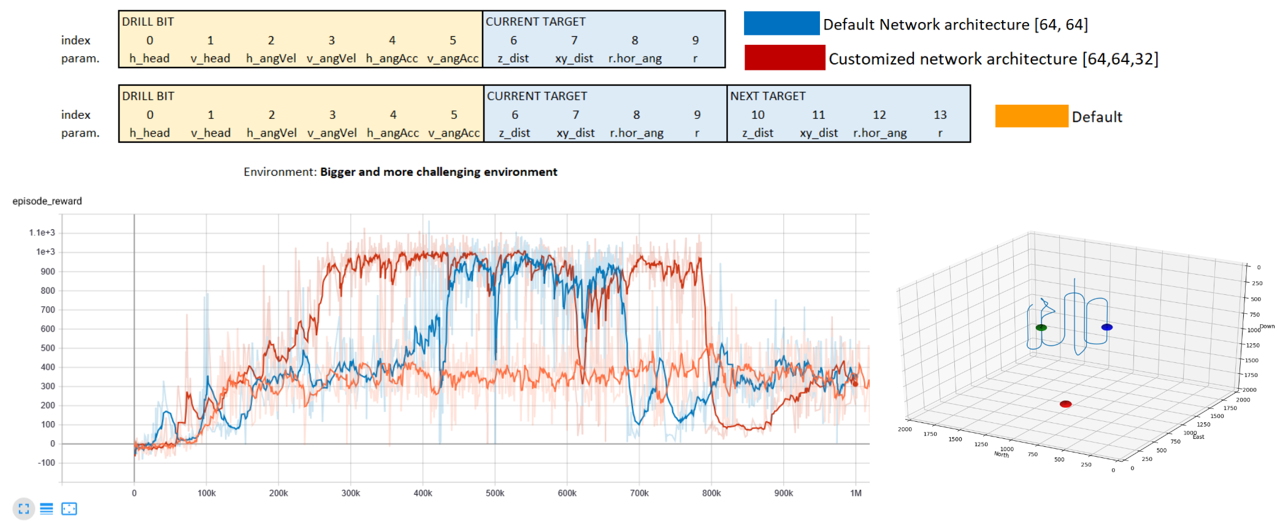
Progress and results: Need for a bigger neural network
Increasing the complexity furter proved the default network to be insufficient
Notes:
When we did the same tests for a bigger, more challenging environment however, the agent really struggled to succeed. As you can see from the blue graph down to the left here, the performance of the agent suddenly plummeted. When we repeated the same training-session with a slightly larger neural network, (illustrated by the red graph), the result seemed to improve, but we still experienced a similar crash later in the training session.
[don't get hung up on the details of the tables, the main idea is that a bigger, more complex environment resulted in the need of a bigger network and more specialized training]

Slide 28
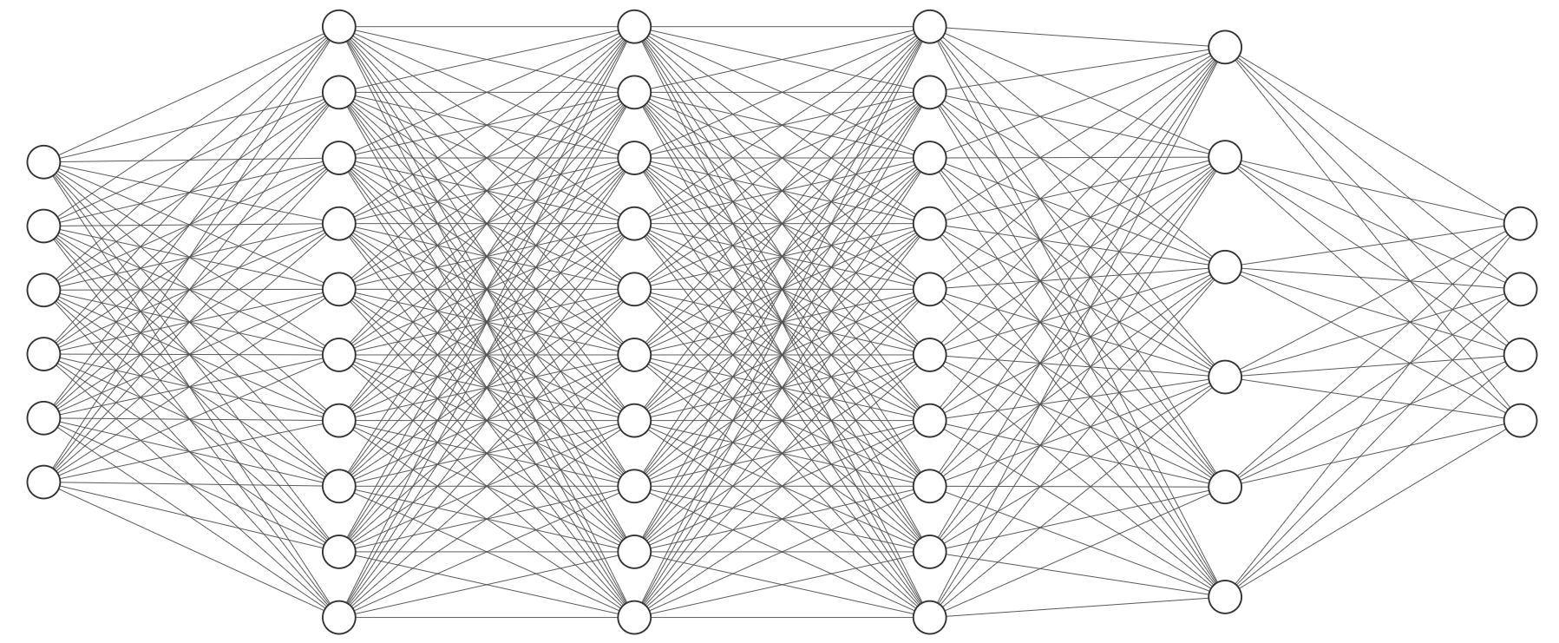
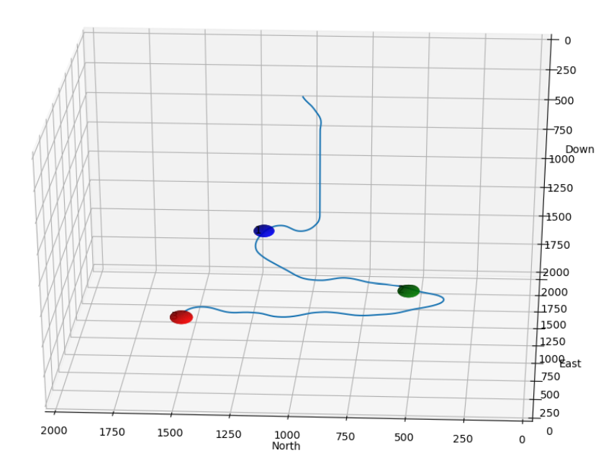
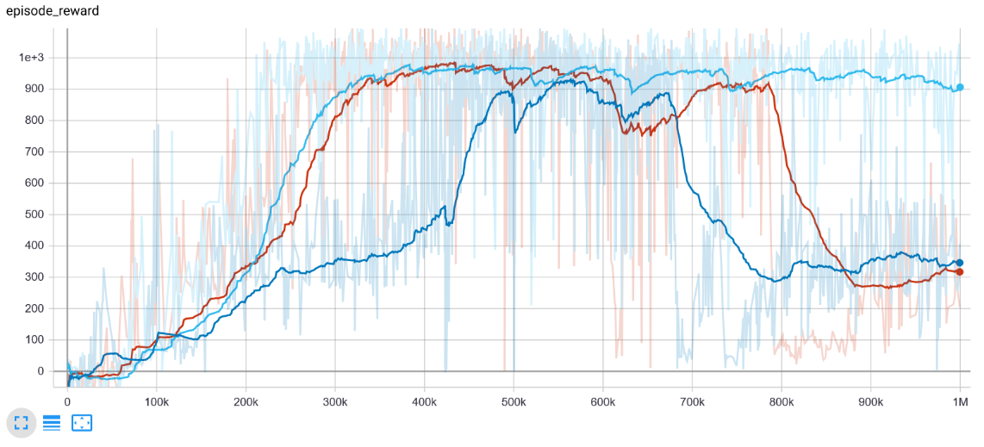
Progress and results: Increasing the size of the neural network
* the number of nodes is not representative
Notes:
We then tested with an even bigger network which managed to avoid the sudden drop in performance so that the agent finally was able to hit the targets in a bigger environment. Going on from this point we gradually increased the size of the network every time we increased the complexity of the environment.

Slide 29
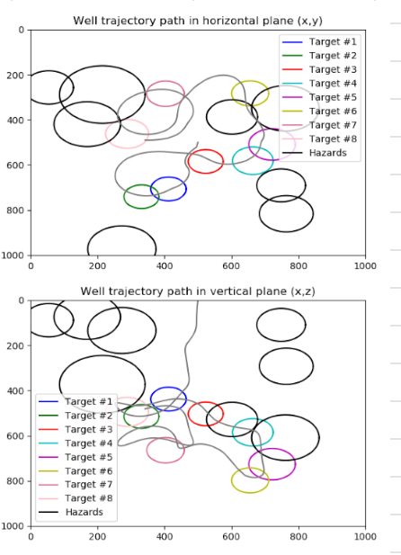
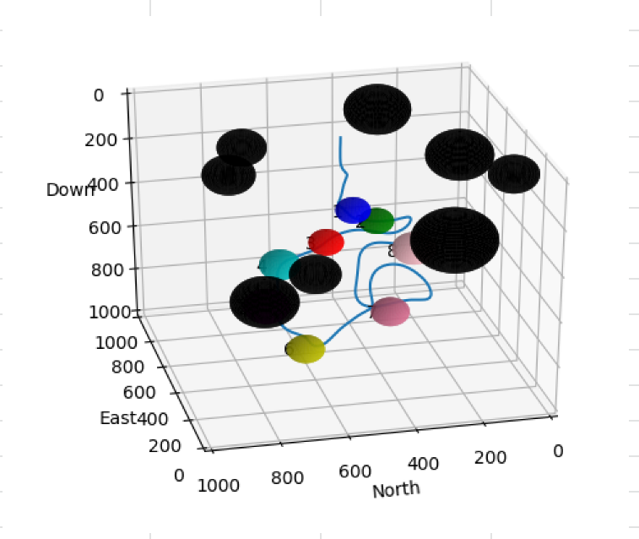
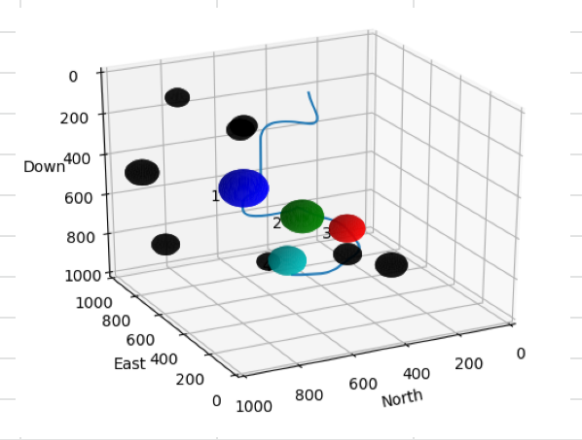
Progress and results: Improved results
At how high complexity are we getting good results? (Num target, Num hazards, size of env, training time)
Big networks with many input nodes
400K
600K
Notes:
Best: 8-8

Slide 30
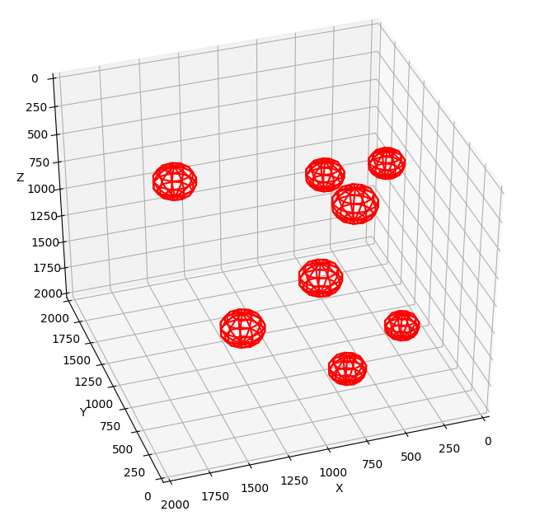
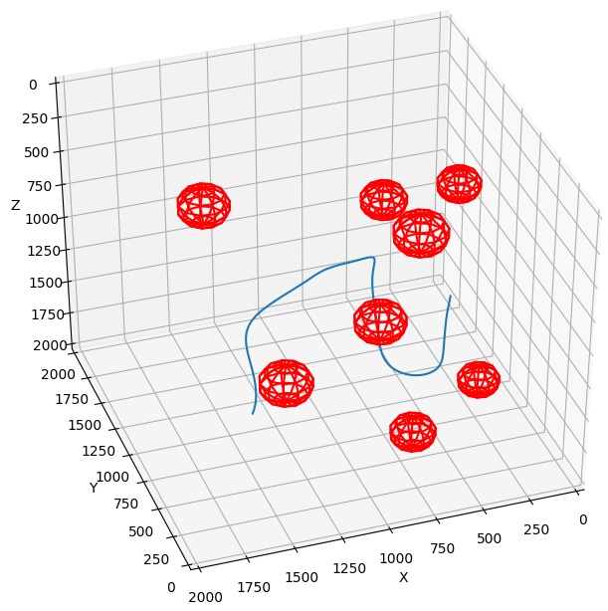
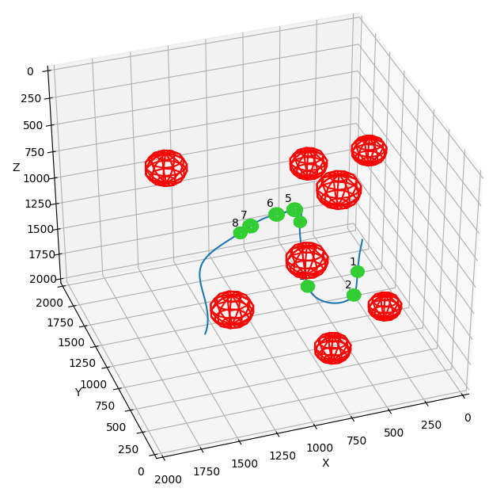
Progress and results: Monte Carlo method
1: Generate random hazards
2: Generate a random well path that adheres to the curvature limitations
3: Place the target balls randomly on the generated well path
Notes:
...Still we experienced that some of the random spawning targetballs was very hard/impossible to reach in a smooth manner. To solve this issue we implemented....
Håkon

Slide 31



Progress and results: Improvement using the Monte Carlo method
Monte Carlo: Converging after ~400k
Radonly generated: Converging after ~800K
Monte Carlo: Reaches max value after ~150k, but unstable
Notes:
Faster training probably due to the fact that the agent only

Slide 32




Progress and results: Improvement using the Monte Carlo method
Randomly generated
Monte Carlo generated

Slide 33


Progress and results: Improvement using the Monte Carlo method
Adding Hazards
Issues with stability

Slide 34
Progress and results: Monte Carlo method takeaway
Fast training time (at least with no hazards)
Stability issues whan Hazards are added
Have not done enough training with Hazards and different networks to draw a definite conclusion
The paths themselves are not that much improved since the results from the "random" spawning are really good

Slide 35






Progress and results: Testing THE
Randomly appearing targets went well, slower drill speed
With many hazards – kinda terrible

Slide 36

Progress and results: What worked and what didn't
Rewards: Rewards should be closely linked to the visible states
Observation space: Should be compact and intuitive
Algorithms: Deep Q-Network (DQN) with extension "Double Deep Q-learning"
Neural network: The size should match the level of complexity in the environment
Policy: Multilayer perceptron with layer normalization (LnMlp)
Hyperparameters: Make sure that the learning rate is not too high

Slide 37

Discussing the results: What to improve
The paths are at times a bit "wiggly", which is not the optimal path
The values that creates movement limitations have not been fine tuned
We have not landed on an optimal network architecture. However in general increasing the observation space will need a bigger network
Network seems to "crash" on bigger observation space. Could be down to network architecture. Better computers could maybe solve this?

Slide 38


Personal reflections
Learned about how we work virtually from home
Tested out how it is to lead a team
Steep learning curves
Impressed how Equinor solved the issue with the internships, considering the difficult times

Slide 39
Github repository
https://github.com/equinor/team-dogleg
Read the README and you should be good to go

Slide 40

Thank you...
To our great mentors, specifically Sondre and Jon.
To our computers for suffering on our behalf
To google and stackoverflow
To Equinor, for a great summer and a challenging and fun case!
And to you for the attention :)

Slide 41


Algorihm you said?
* Even though other algorithms seemed promising they very often led the agent into local maximums

Slide 42
Algorihm you said?

